Slide 1

Glass Charts Project
A Google Glass application
Created by:
Camilo Sad
Carlos Rebelato
Cristina Bazzano
Faculty Advisor:
Jeremy Hajek
Notes:
Cadu - outline

Slide 2
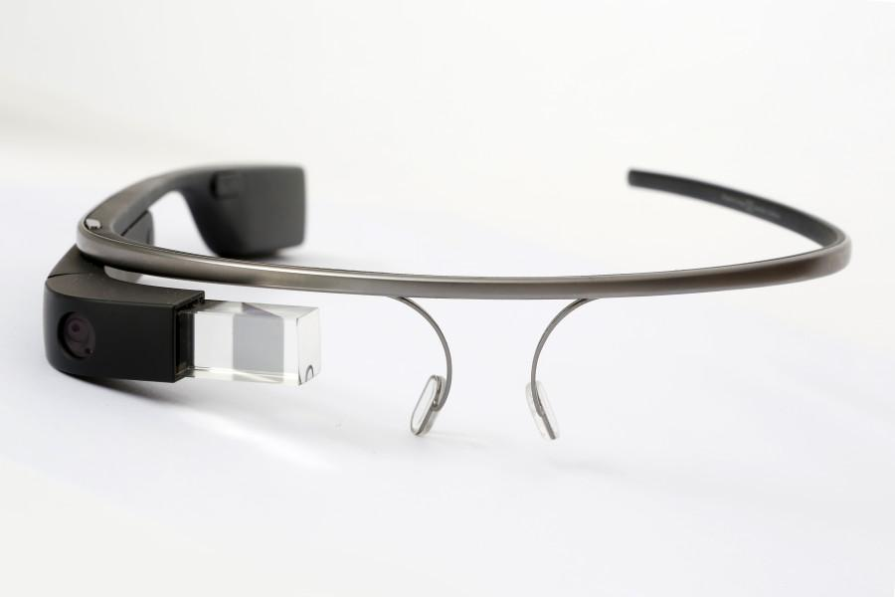
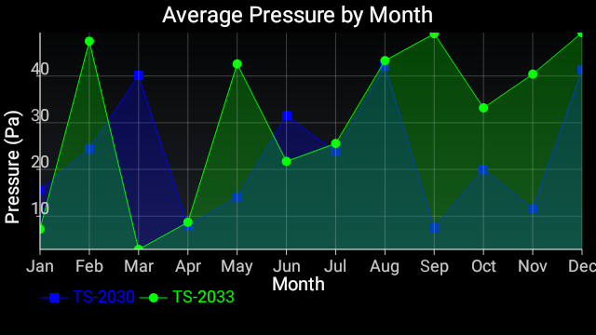
1. Introduction
Google Glass application
Help to keep control of environment measures
Ease the technicians work
The platform is the key
Notes:
Cris - Our project is a Google Glass application
It retrieves environment data from an online server and presents it in different charts to highlight the measurement variations.
Our goal is to enable technicians and all interested workers the access to this data while doing other tasks.
And now we will talk about how this platform can make it possible.

Slide 3
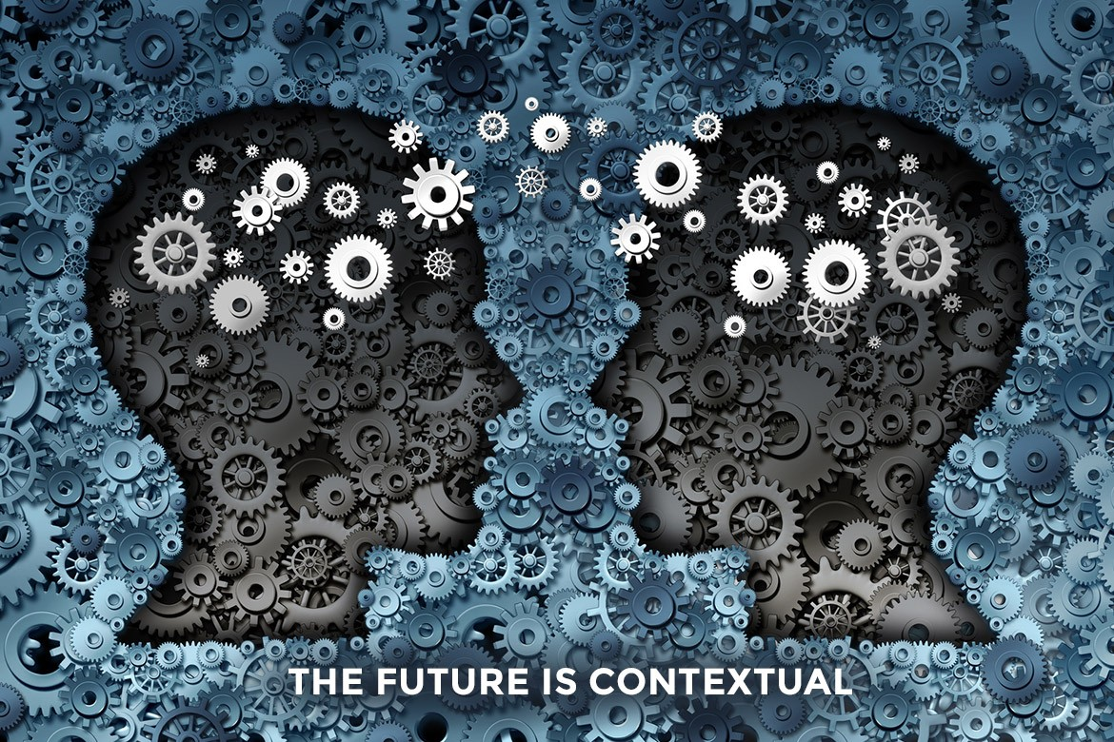
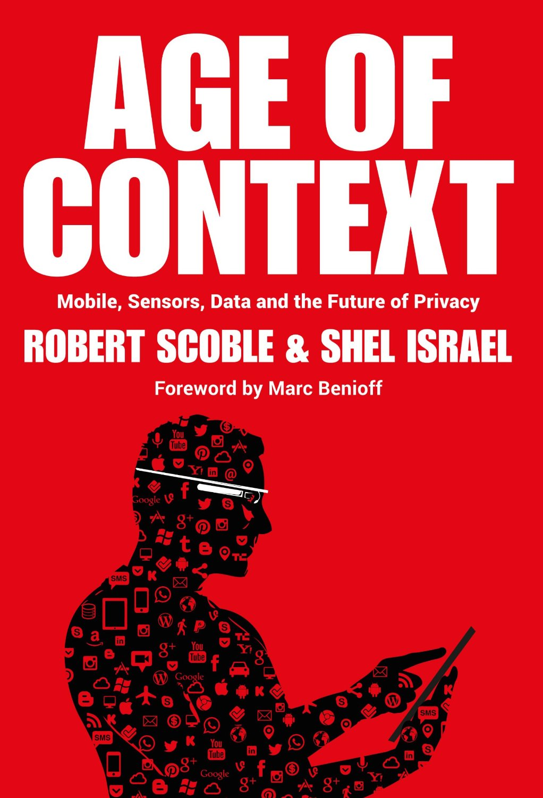
2. The platform - Predictions
Understand behaviors
What, when, where and who
Automate tasks
Notes:
Google Glass is one of the main technologies he talks about in his book. And this is what he says:
Contextual technologies will be able to understand people’s behaviors
They will know what you are doing, when, where you are and who is around you, and even who is having a conversation with you
And based on that kind of information, it will automate your tasks

Slide 4
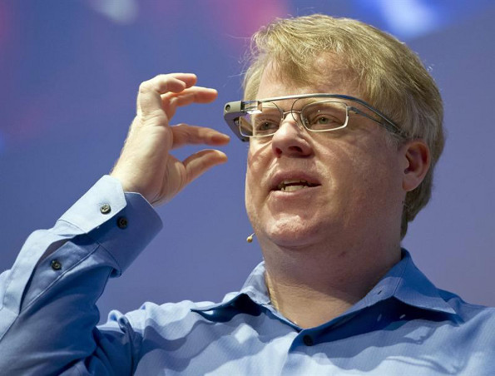
2.1. The platform - Experience
Notes:
So after getting his first pair of Google Glass, he said he would wear them for one entire year…

Slide 5
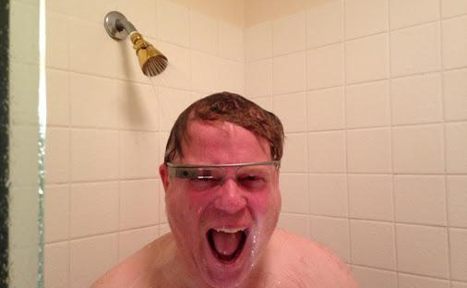
2.2. The platform - Experience
“You thought I was kidding when I said I would never take them off.” - Robert Scoble
Notes:
He took it serious!
This picture was taken from his own Google Plus profile. It was posted on April, 2013, with this subtitle.
And he also says that the glass survived being wet without any problems.
Well, we don’t know if he actually used the glass for a whole year without taking them off.
But we do know that he is not using them anymore. He said it publicly.
And the reason why he stopped using it is because he didn’t have a real purpose, he just wanted to use it and see what happens.
So, after a few years, we know that it is possible for those contextual technologies to do most of the things he predicted.
But that is not the idea behind Google Glass.
We are here to show what Google Glass really is nowadays, and that we have found a better purpose for it.

Slide 6
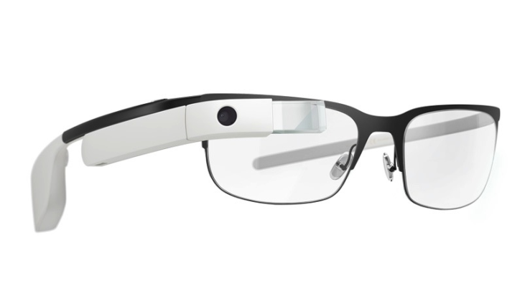
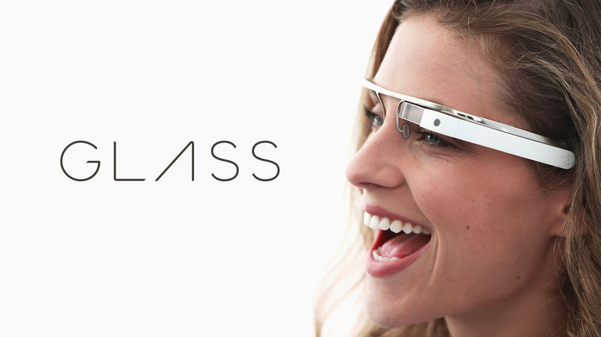
2.3. The platform - Nowadays
Ubiquitous computer
Easy interaction
Google integration
Purpose
Notes:
Cris
And here is the google glass.
It work best with information that is simple, relevant, and current
As Robert Scope proved, you can carry and access it at anytime and everywhere
Glass is designed to be there when you need it and out of the way when you don't
It’s easy to interact with it, you can use touch, gesture and voice command.
You can integrate it with your google account and have access to all your data and also synchronize it with your phone and access msg and calls
So it really achieves the purpose of a compact platform that give the users fast informations and it’s always ready to use without disturbing other activities, what makes it use worth using.

Slide 7
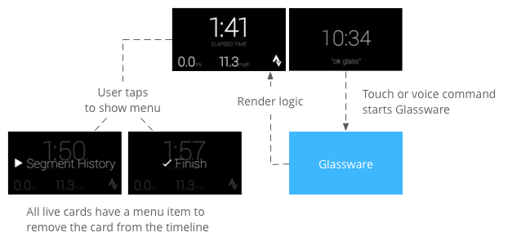
2.5. The platform - How it works
Cards
Simple layout
Text, image, video, HTML
Principles and patterns
Notes:
Cris
And how it works is different from the mobile application that we are used to, the google glass has a more simplistic design
It runs with the concept of cards, where each view of the application is a card
And when designing an application for it you have to follow some principles and patterns to be able to deliver the informations you want in the best way that the platform can handle

Slide 8
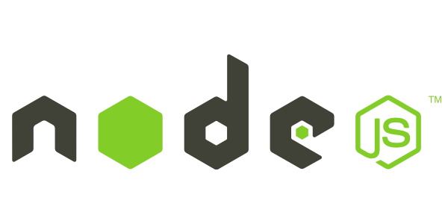
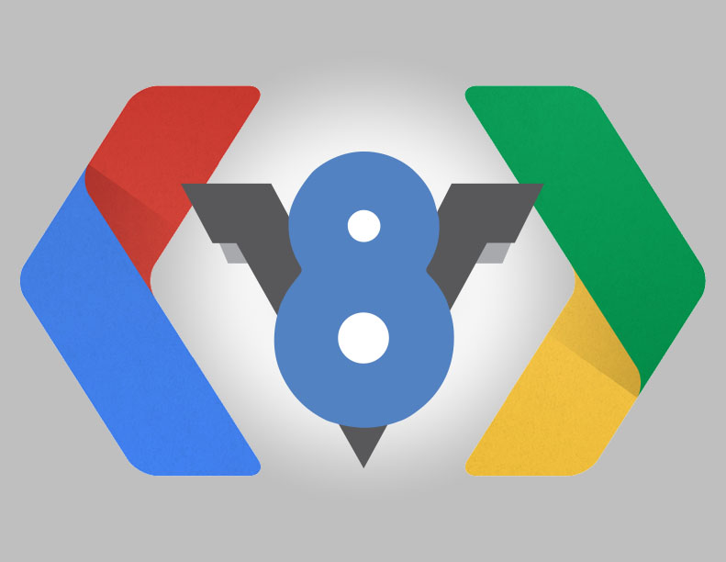
3. Technologies - NodeJS
Event-driven
Non-blocking I/O model
NPM
V8 Engine
Notes:
Cadu
Node.js uses an event-driven, non-blocking I/O model that makes it lightweight and efficient. Node.js' package ecosystem, npm, is the largest ecosystem of open source libraries in the world.

Slide 9

3.1. Technologies - MongoDB
Free and open-source
NoSQL database
JSON structure
Notes:
Camilo
MongoDB is a free and open-source cross-platform database. It’s classified as a NoSQL database, going far away from what the usual databases, such as MySQL, are. It works with dynamic documents through the use of the JSON structure. MongoDB is developed by MongoDB Inc. and runs under the open source license.

Slide 10
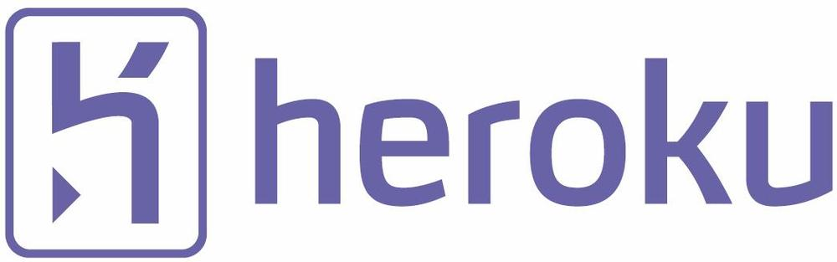
3.2. Technologies - Heroku
Cloud Platform-as-a-Service
Started in 2007
Developers focused on developing
Easy management
Notes:
Camilo
Heroku is a cloud engine that works like as a Platform-as-a-Service, providing an environment for customers to develop, run and manage applications. It has been in development since 2007.

Slide 11
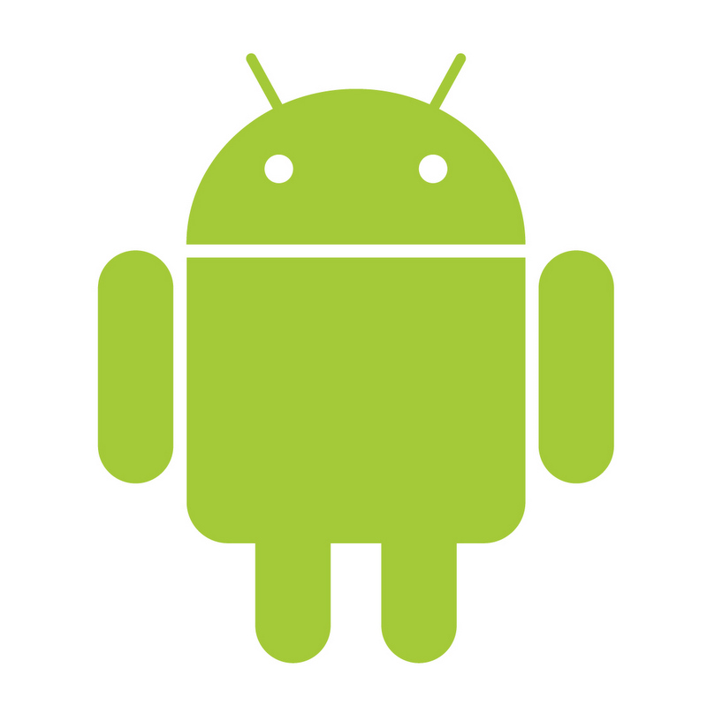
3.3. Technologies - Android
OS based on Linux
Currently developed by Google
Touchscreen
Most used mobile OS
Open source
Notes:
Cadu
Android is an operational system based on Linux and nowadays it is developed by Google. It was designed to work mainly with devices with touchscreens. This is the most used mobile operational system over all the world. Android’s source code is provided by Google and runs under the open source license.

Slide 12
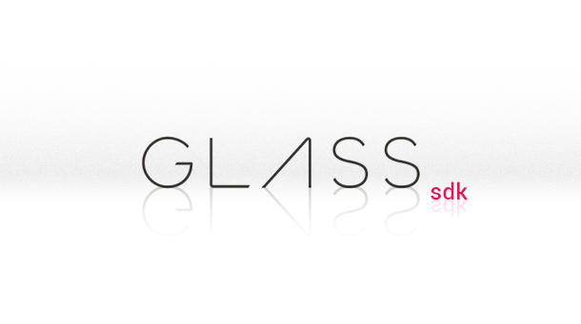
3.4. Technologies - GDK
Add-on to Android SDK
Glassware
Android 4.4.2 API 19
Notes:
Cadu
To develop to Google Glass, a specific development kit is needed, the Glass Development Kit (GDK), which is an add-on to the Android SDK that lets you build Glassware that runs directly on Glass. This development kit works with Android version 4.4.2 running the API 19.

Slide 13
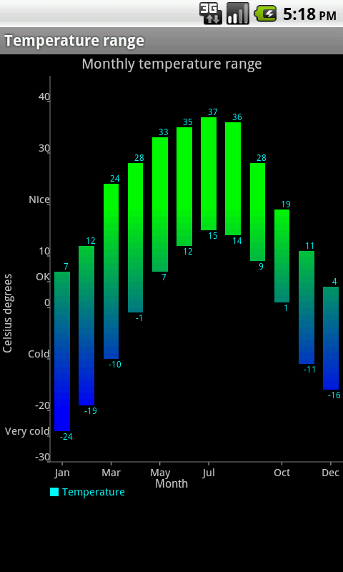
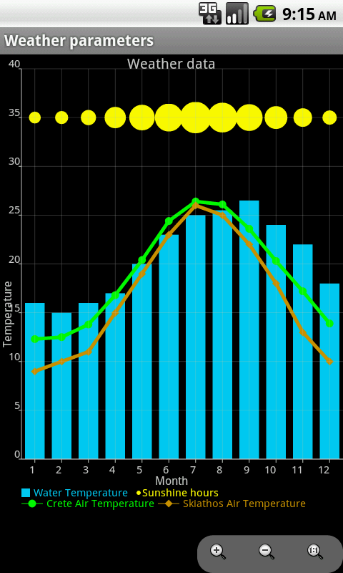
3.5. Technologies - AChartEngine
Charting library for Android
Large amount of chart types for different data types
Simple enough to be supported by the platform
Notes:
Cris
To present the environmental data we used the android library AChartEngine.
It is a charting library for Android applications. It supports a large amount of chart types, matching all the needs based on the data that is going to be presented.
What made up our mind about this library is the fact that it is simple enough to be supported by the Google Glass and implemented without big difficulties

Slide 14
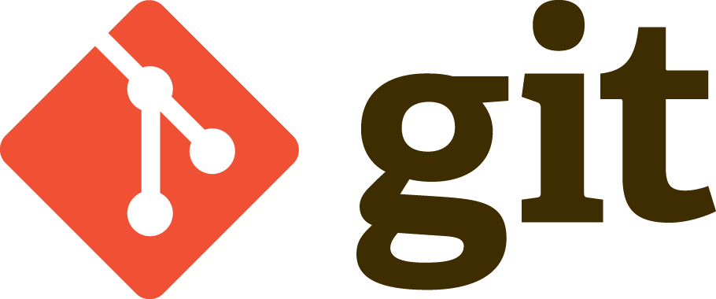
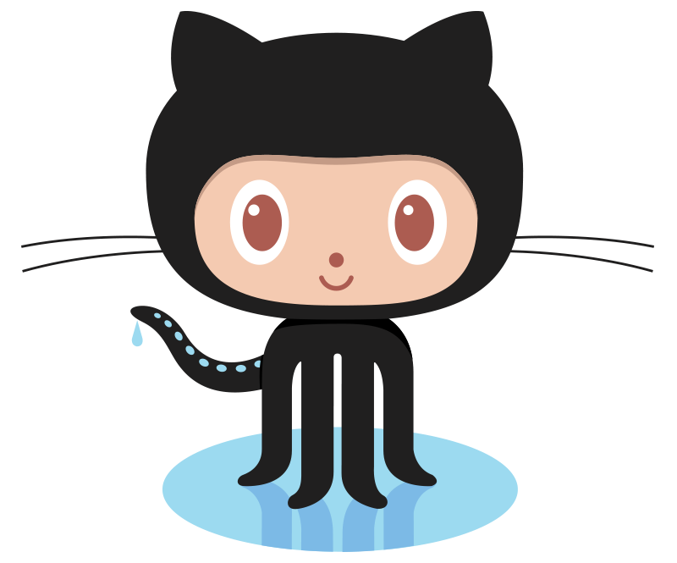
3.6. Technologies - Git
Version control system
Developed to build Linux
Speed and teamwork
https://github.com/Illinois-tech-ITM/BSMP-2016-Data-Analytics-and-Presentation
Notes:
Camilo
Git is a distributed version control system that emphasizes speed and teamwork. Initially, it was developed to help to build Linux, but it was adopted by other projects.

Slide 15
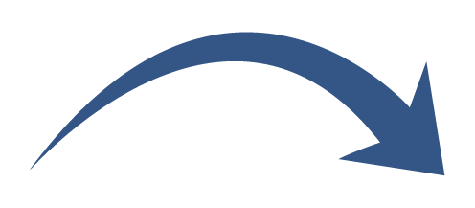
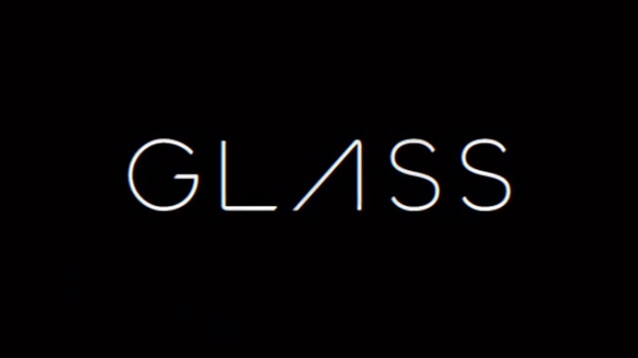
4. Connection Flow
Notes:
Cadu

Slide 16

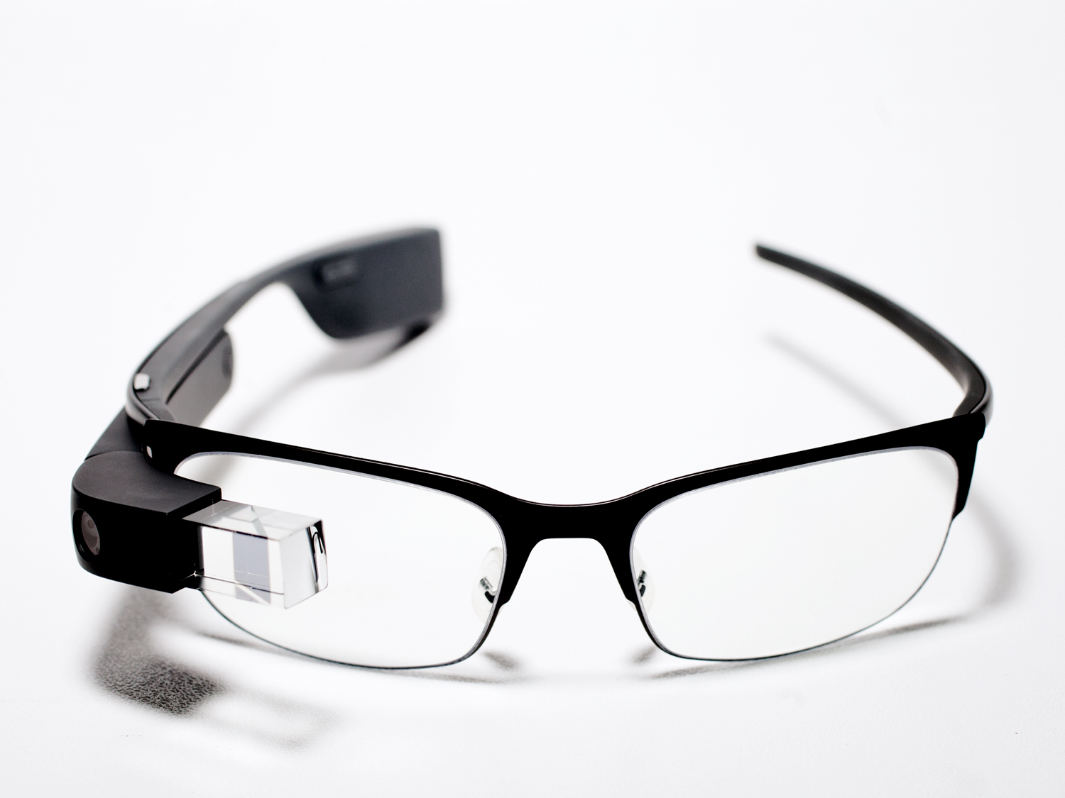
5. Development Difficulties
Small community
Code troubleshooting
Price
Permission to acquire
Software version
Notes:
Cris
The choice of the Google Glass as our Platform came with a lot of difficulties
It has a small development community, which means less developers, less knowledge shared and then less error solutions
There is no google glass emulator to test the application, so then the troubleshooting has to be done directly in the platform, what means you need the platform to program for it
It is also not a cheap device, it cost around $1500 (fifteen hundred dollars) and there is about only 25 devices in all Chicago.
What added to this small number was the need of a Google authorization to acquire one Google Glass.
And a last point is that it runs in a old version of Android outpast 3 versions by the last release which ties the application to no Android updates and less features available.

Slide 17
5.1. Difficulties - But … why?
Alright, but if the situation is really this bad, why do you still want to use it?

Slide 18
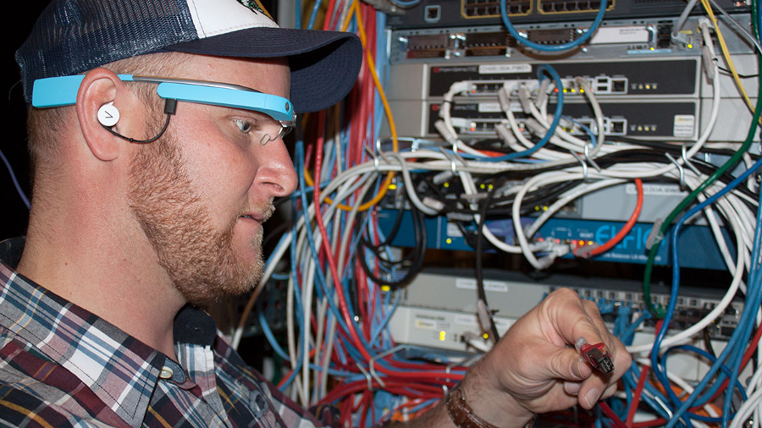
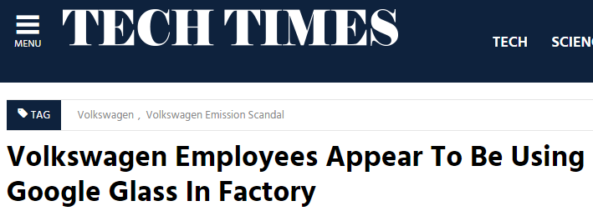
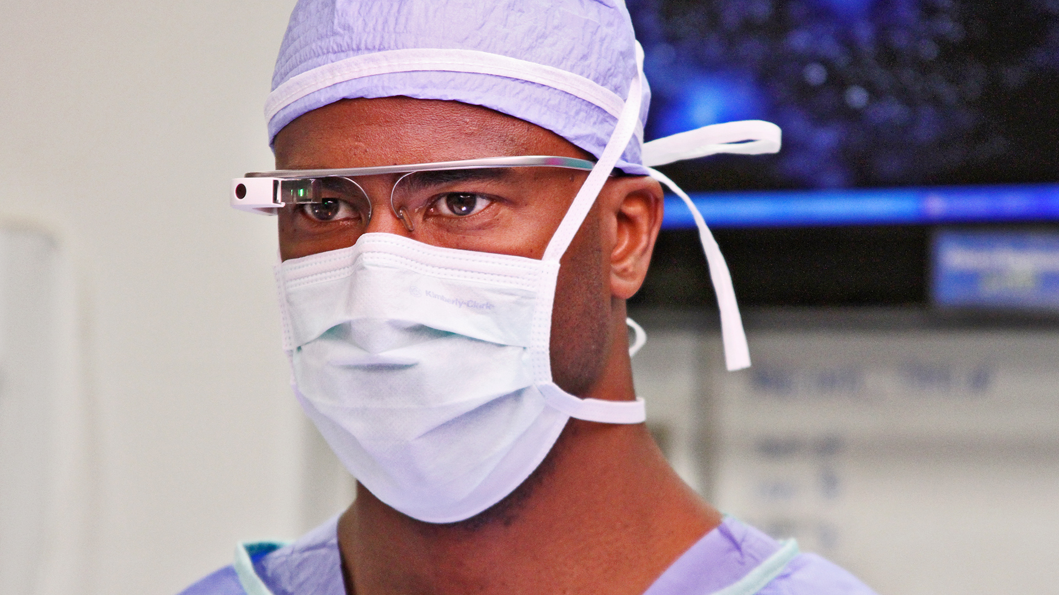
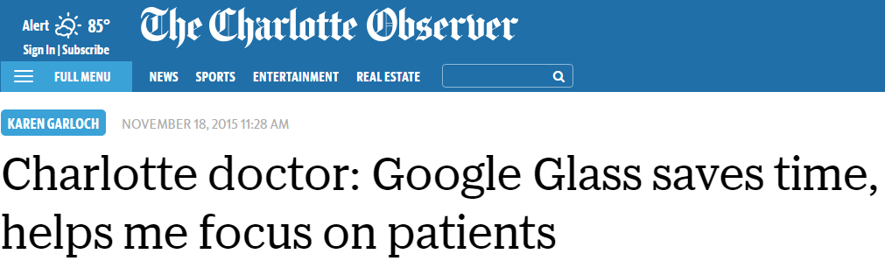
5.2. Difficulties - BECAUSE YES!

Slide 19
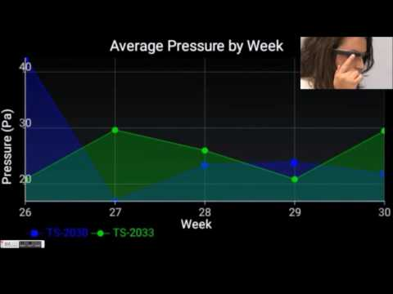
6. Application Demo

Slide 20
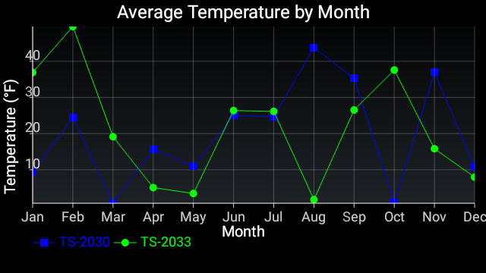
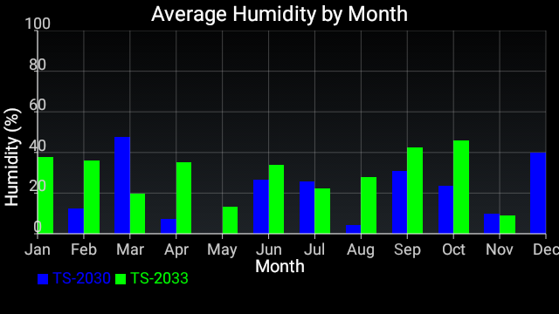
7. Conclusion
Tough task
Worth it
Know what you have
New motivation
Notes:
Cadu

Slide 21
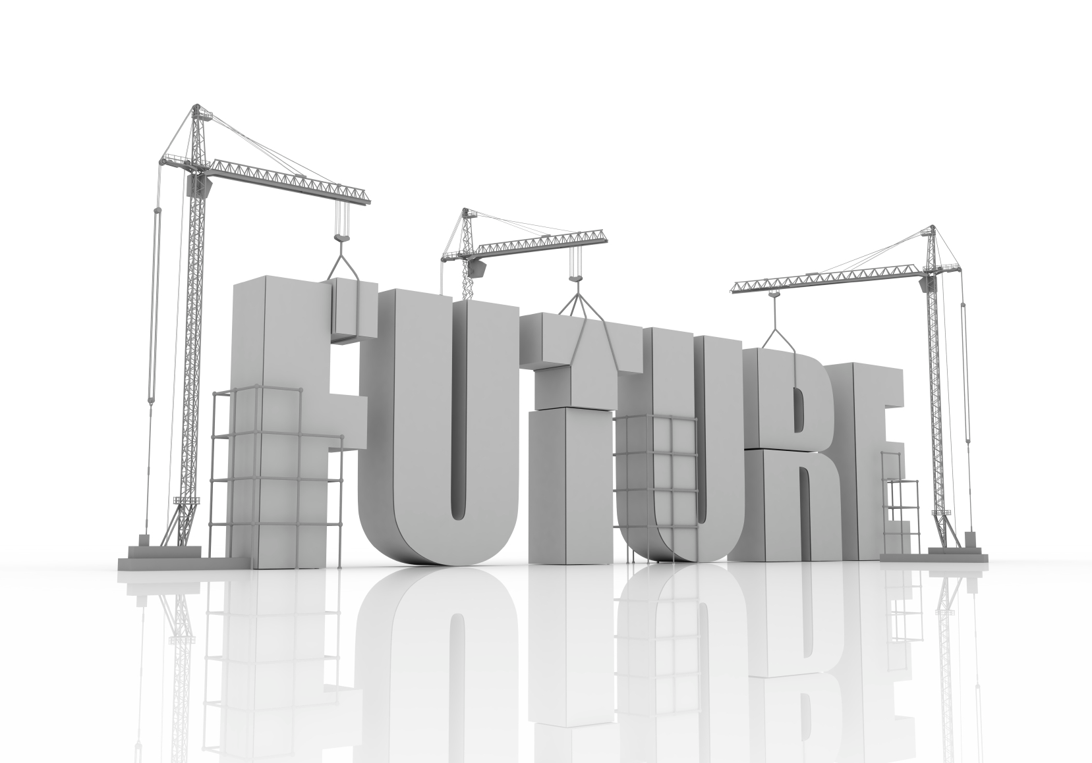
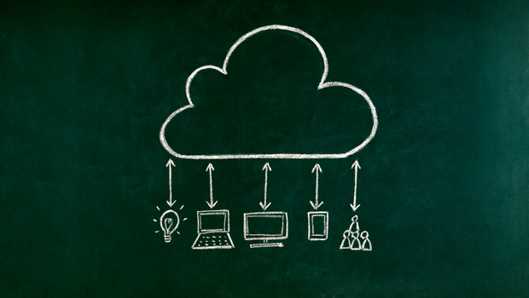
8. Future Work
Voice commands
Charting libraries
Geolocation
Security
Notes:
Camilo

Slide 22
9. References
https://github.com/ddanny/achartengine/
https://www.android.com/
https://developer.android.com/index.html
https://developers.google.com/v8/
https://github.com/ddanny/achartengine
http://www.tecmundo.com.br/google-glass
https://en.wikipedia.org/wiki/Google_Glass
https://developers.google.com/glass
https://www.heroku.com/
https://devcenter.heroku.com/articles/getting-started-with-nodejs
https://www.mongodb.com/
https://docs.mongodb.com/getting-started/
https://github.com/

Slide 23
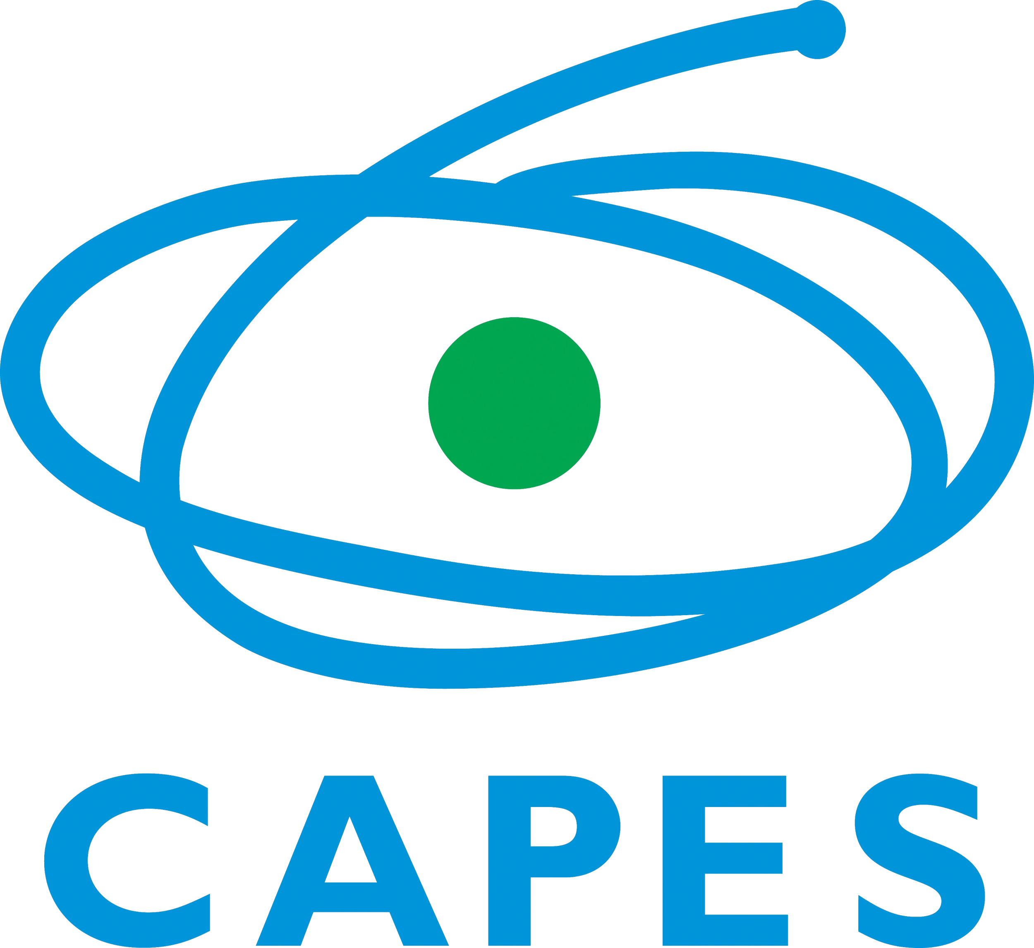
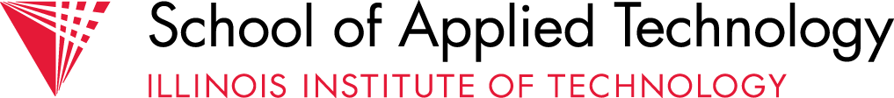
Thank you!

